Slide 1
MultiModal Interactive Paint
Team Members: Daniel Mederos, Jim Louro, Camilo Rivirie Product Owner: Francisco R Ortega
Instructor: Masoud Sadjadi School of Computing and Information Sciences Florida International University
Final Presentation
Spring 2017
Notes:
7 seconds.( I will select 2 best slides (i will give them extra points and students will present for CIS committee)
Greet your audience, thank them for attending your presentation, introduce yourself, introduce your project, introduce your team members, and quickly indicate what each of you did in a high-level manner, and put more emphasis on your part/contribution.

Slide 2
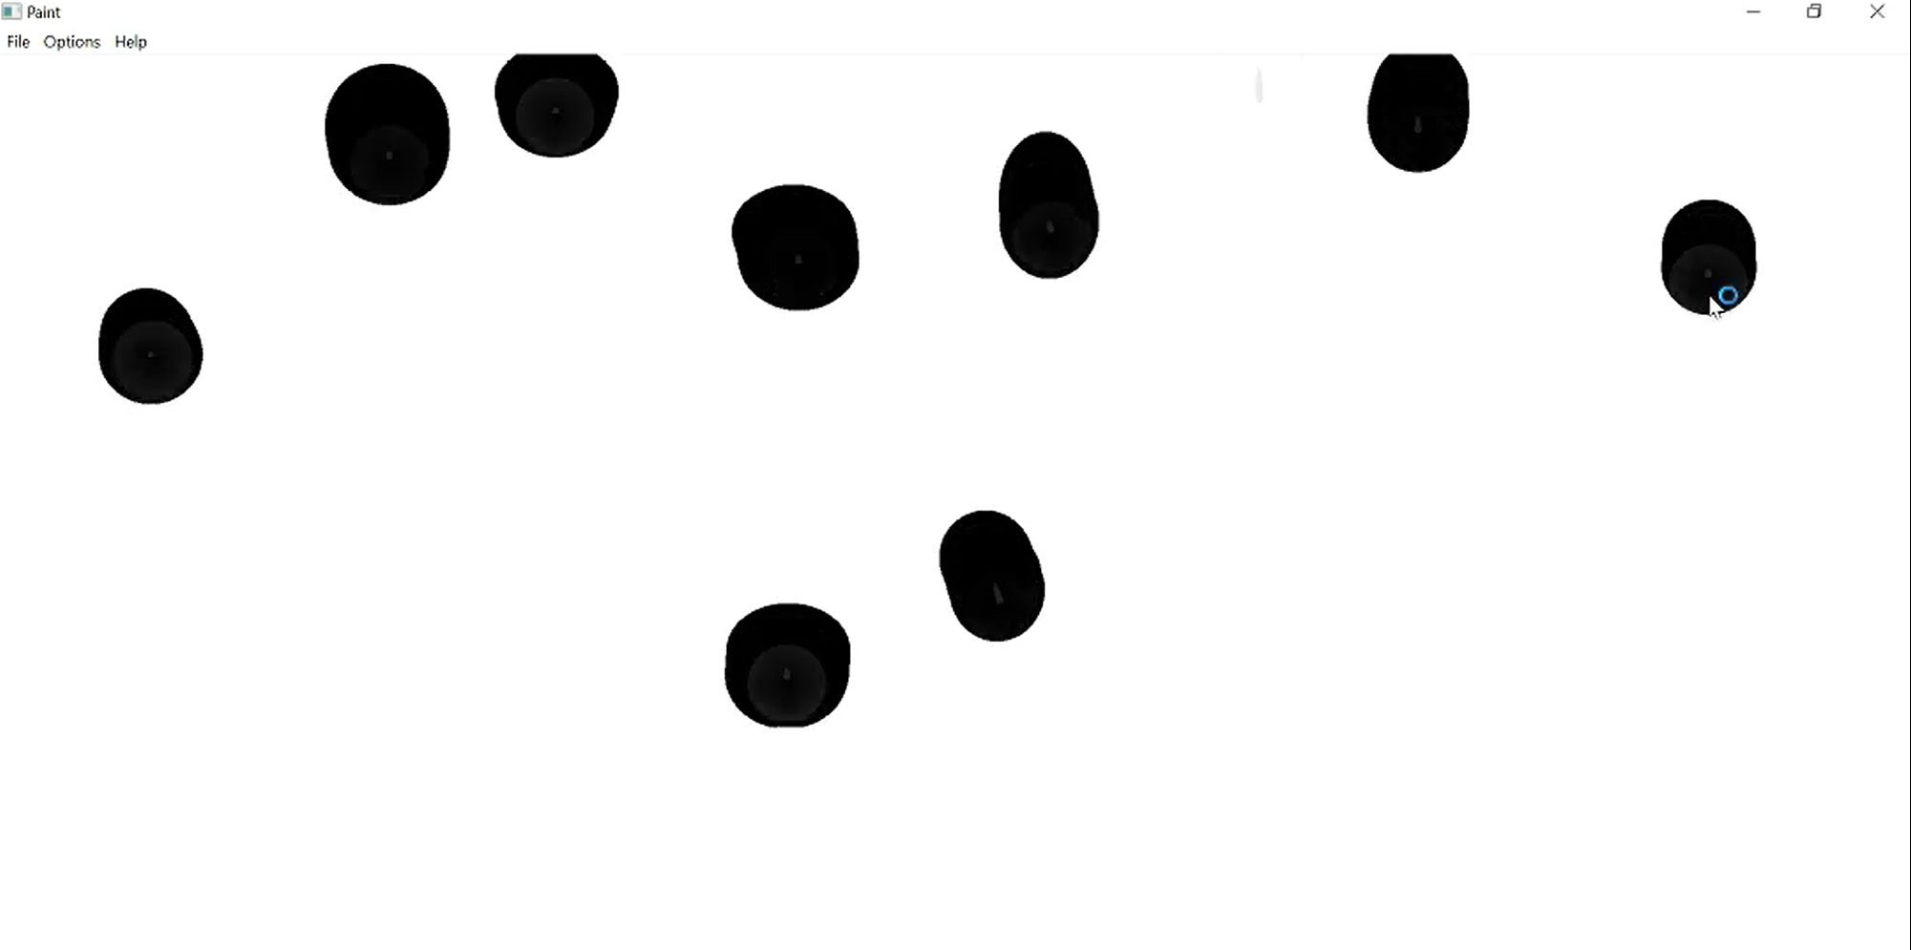
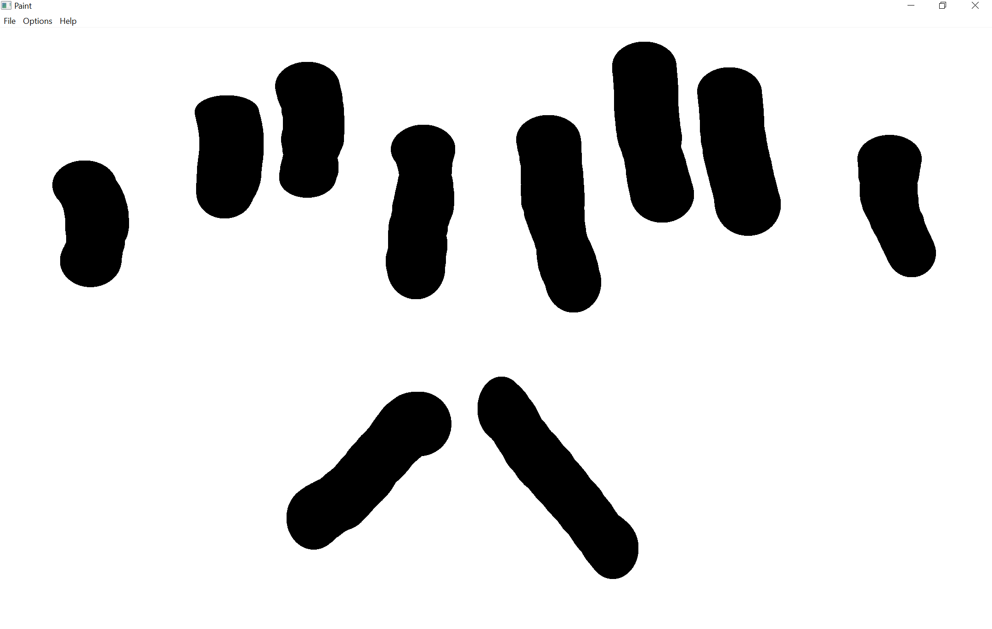
Project definition
Notes:
10 seconds.
Introduce the problem that the whole project (in all versions) tackles with GIF or screenshot.

Slide 3
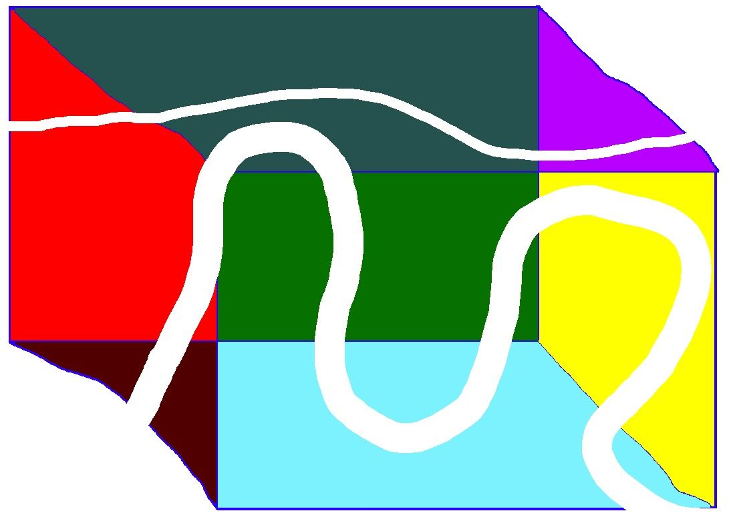
Project definition
Notes:
20 seconds.
Introduce the problem that the your project (in new version) tackles with GIF or screenshot.

Slide 4
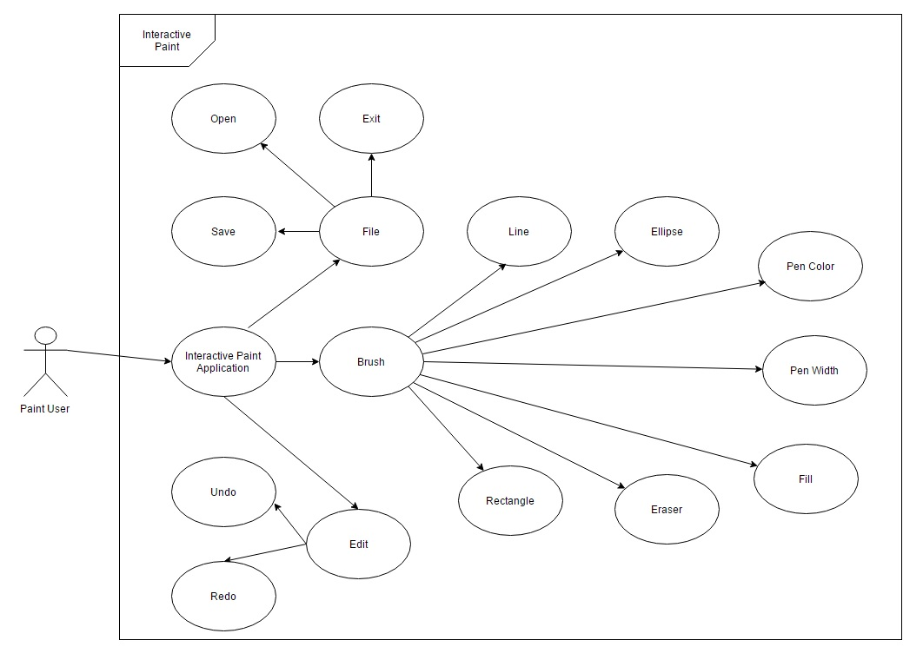
Requirements: Object Design
Notes:
5 seconds
Show the Use Case Diagram for the whole project. Highlight your use cases.

Slide 5
System Design: Architecture
Actor Model - Components are independent actors in an application, the end user will chose to have a Single mode with 1 input and 1 actor or multi mode with up to 10 actors(assuming one per brush).
Object Model - In order to avoid a complex hierarchy we separated the models into two forms a multi and a single where the File features(Save & Open), resize, Exit and minimize all perform a basic operation in both forms. In Single mode the canvas has options to change the brush style by implementing a shape class that includes but is not limited to having a rectangle ellipse free dawr line and an eraser. Along with the option to fill within an image or section and to change the brushes size and color. Single also keeps track of the shapes created in a FIFO order to allow redo and undo features. While Multi has separate event handlers that are always listening to new touch events to create a new brush on the canvas for the drawing. Multi also gives you the options to clear the canvas of all drawings. Seeing as how multiple brushes will have full access to the canvas at every point in time it would be very complicated to implement various styles of pens efficiently in short time or to have a FIFO order at all with the design.
Notes:
20 seconds
System design: Highlight the parts that you contributed to them.
1. System decomposition; identify the architecture patterns used
2. System deployment – h/w and s/w requirements

Slide 6
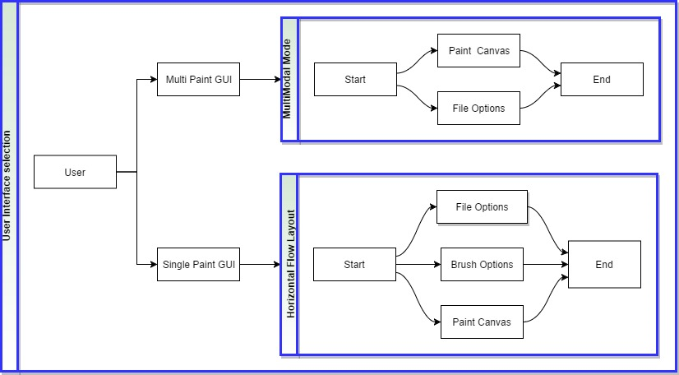
Minimal Class Diagram
Notes:
10 seconds.Minimal class diagram. Highlight the classes that you created/modified
Identify the design patterns used (one or more slides).

Slide 7
User Stories
User Story #359 - Create MultiModal mode for multiple pen touches
User Story #320 - Implement a line brush to read in mouse movement
User Story #
Notes:
5 seconds.
List the user stories that you worked on them.(put in order of importance). Stay focused on the parts that you have been working.

Slide 8
User Story #359
User Story #359 – Create Multimodal mode for multiple Pen Inputs
As a developer, I want to create a mode in the Paint application where we can accept multiple inputs from the user on the same canvas at the same time.
Acceptance Criteria:
1. The application must read multiple inputs and treat them all the same way.
2. The mode must have the same file options as the single mode GUI (Save, & Open)
3. The mode must allow the user to clear the canvas and restart the painting
4. The mode must allow the user to begin different touch points at the same and at various times without causing a delay or an issue with the painting style.
Related Tasks:
As a developer I want to test with multiple pen inputs and different levels of input
As a user I want to be able to create the image with collaboration from others and restart if errors were made
Notes:
60 seconds
The tile of user story
The most important user story you worked on it. You have to describe this one very well and be proud of that.
Please present and show the complexity of your work, code, algorithms, and technical challenges and technologies you have used. (you could use screenshot if you want. Visual presentations are better than text presentation)
Go into the details of the most important/significant tasks using bullet lists or visual graphs or state chart diagram
Sequence Diagram for this user story is mandatory (in another separate page if required)
Demo using screenshots or GIF (in another separate page if required)

Slide 9
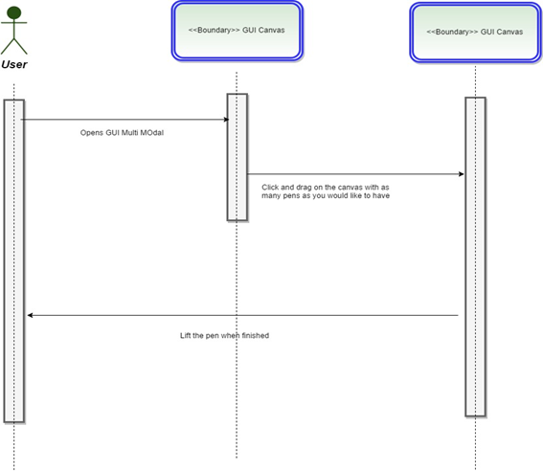
User Story #359

Slide 10
User Story #2
Notes:
20 seconds
The tile of user story
Please present and show the complexity of your work, code, algorithms, and technical challenges and technologies you have used. (you could use screenshot if you want. Visual presentations are better than text presentation) - Go into the details of the most important/significant tasks using bullet lists or visual graphs or state chart diagram - Demo using screenshots or GIF (in another separate page if required)
Sequence Diagram for this user story is optional

Slide 11
User Story #320
User Story #320 - Implement a line brush to read in mouse movement
As a developer, I want to implement a class that allows the user to freehand draw on the painting application.
Acceptance Criteria:
1. Must use Qt Widgets
2. Must not depend on other classes only Qt so it can be extended to host multiple input
Related Task:
As a Developer I want to test the line design and trace to match the user input, at different rates, with different colors and different brush sizes
As a User I want to be able to draw different freehand lines
Notes:
20 seconds
The tile of user story
Please present and show the complexity of your work, code, algorithms, and technical challenges and technologies you have used. (you could use screenshot if you want. Visual presentations are better than text presentation) - Go into the details of the most important/significant tasks using bullet lists or visual graphs or state chart diagram - Demo using screenshots or GIF (in another separate page if required)
Sequence Diagram for this user story is optional

Slide 12
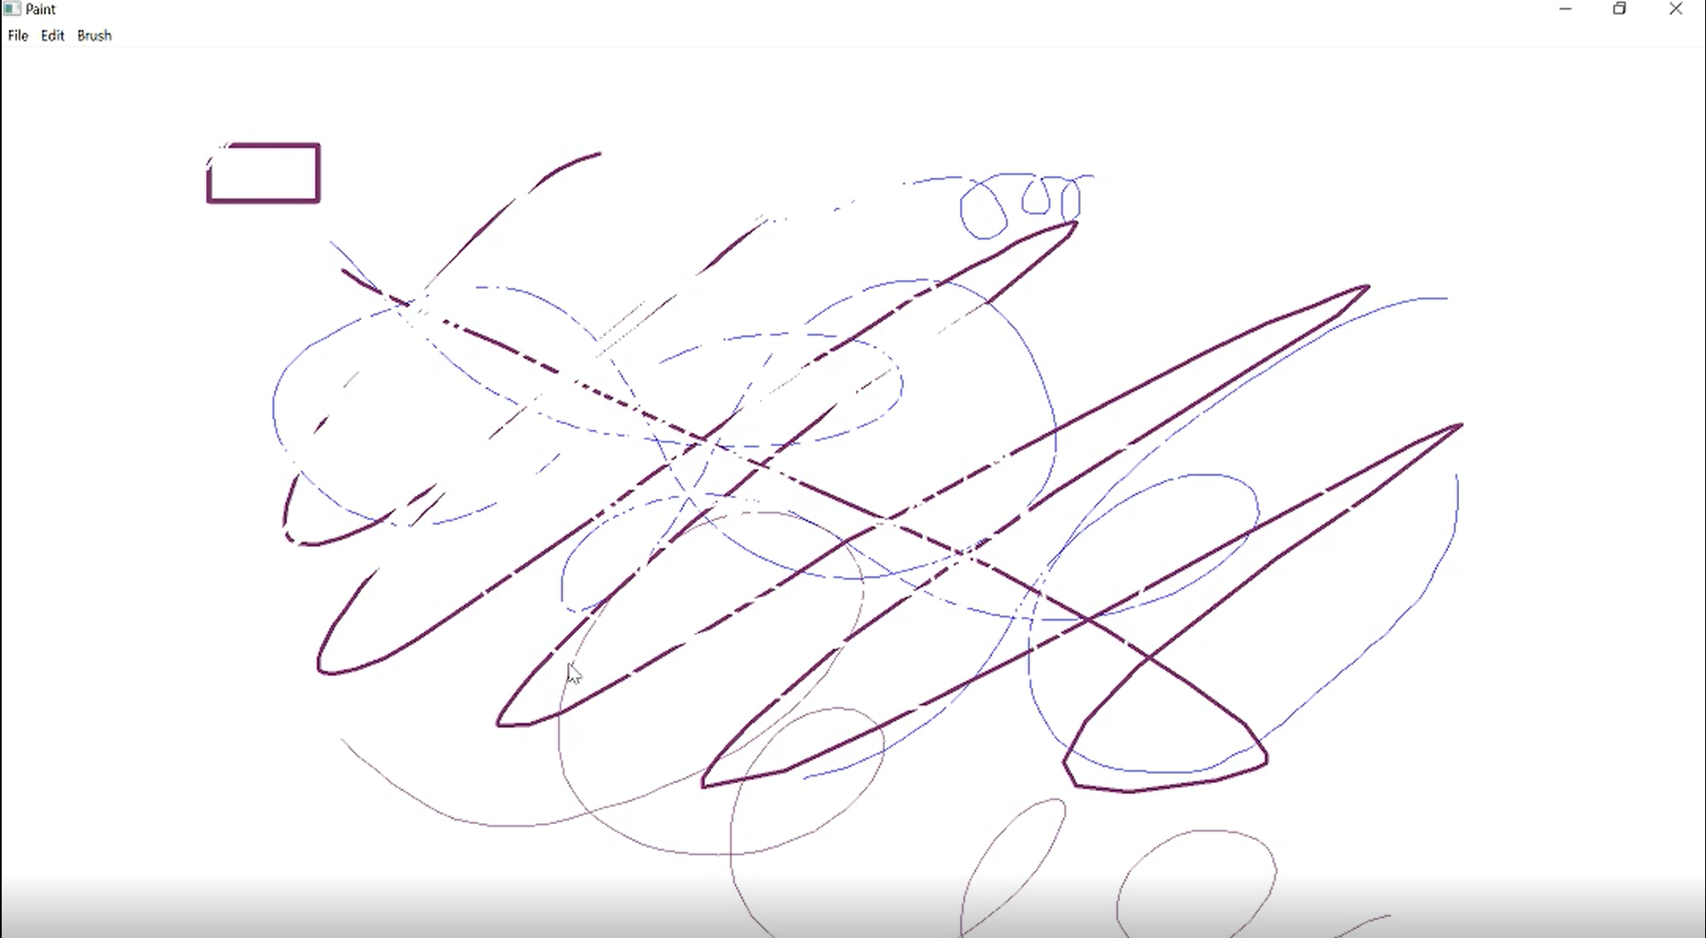
User Story #320

Slide 13
Test Suites and Test Cases
Integration Tests
This iteration of Interactive Paint was built as 2 disjoint projects and there was little integration.
The painting application built by Daniel and Jim was tested by multiple users, each testing different features of the application.
Unit Tests
For the application built by Daniel and Jim, the methods that take that data and adjust it to make drawing easier were tested and the methods that draw to the screen were tested.
Notes:
10 seconds
A description of verification process and Test Suites and Test Cases for one of the use cases.
1 One sunny day and one rainy day for the implemented use cases (one or more slides).
2 Automated test scripts for the implemented use cases (if any) (one or more slides).

Slide 14
Unit Test Case examples Undo
Sunny Day Case:
Test case: Undo
Purpose: to test that the undo button appears when user clicks on undo button Precondition The user must have QT plugin for visual studio and must run the program Input: User clicks on undo button which then a drop down menu appears Expected Result: undo button appears on GUI Canvas from a drop down menu Actual Result: Actual result was found to be the expected result. Status: PASSED
Rainy Day Case:
Test case: Undo
Purpose: to test that the undo button properly lets the user return the canvas to the previous state Precondition The user must have QT plugin for visual studio and must run the program Input: User clicks on undo button which then a drop down menu appears and must click undo Expected Result: returns the canvas to the previous state Actual Result: Actual result was found to be the expected result. Status: PASSED

Slide 15





Summary
Contact Information
Jim Louro Jlour006@fiu.edu
Daniel Mederos dmede001@fiu.edu
Camilo Rivirie crivi001@fiu.edu
Questions?
Thank You!
Notes:
10 seconds
Summarize your contribution, mention your effort for Scrum, Mingle, Github, Google Drive Documentation and minutes
Include your contact information
Ask if anyone has any questions for you.
Thank your audience

